Slide 1
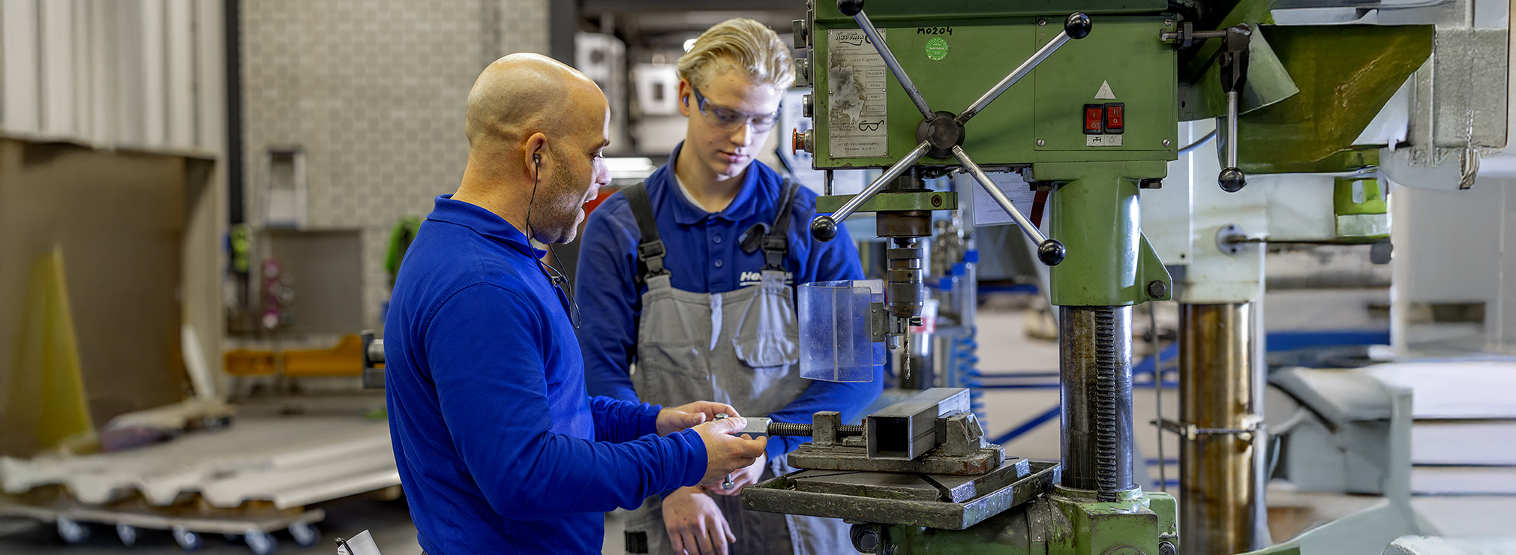
Toolbox
Machine safety: Drill press
Company name and date

Slide 2
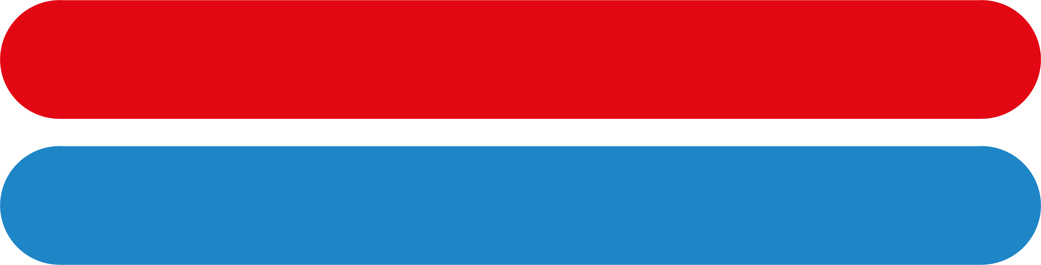
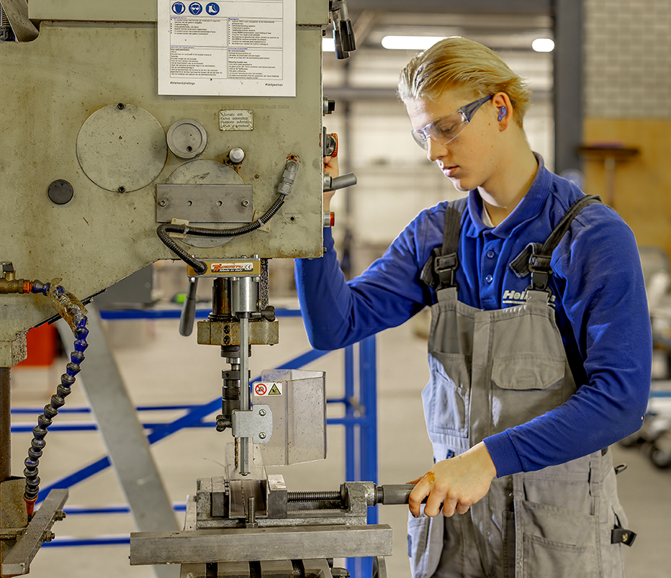
Contents
Safe and healthy working practices | Machine safety: Drill press
Why machine safety?
Top 3 accidents
Safe machine
What can you do yourself?

Slide 3
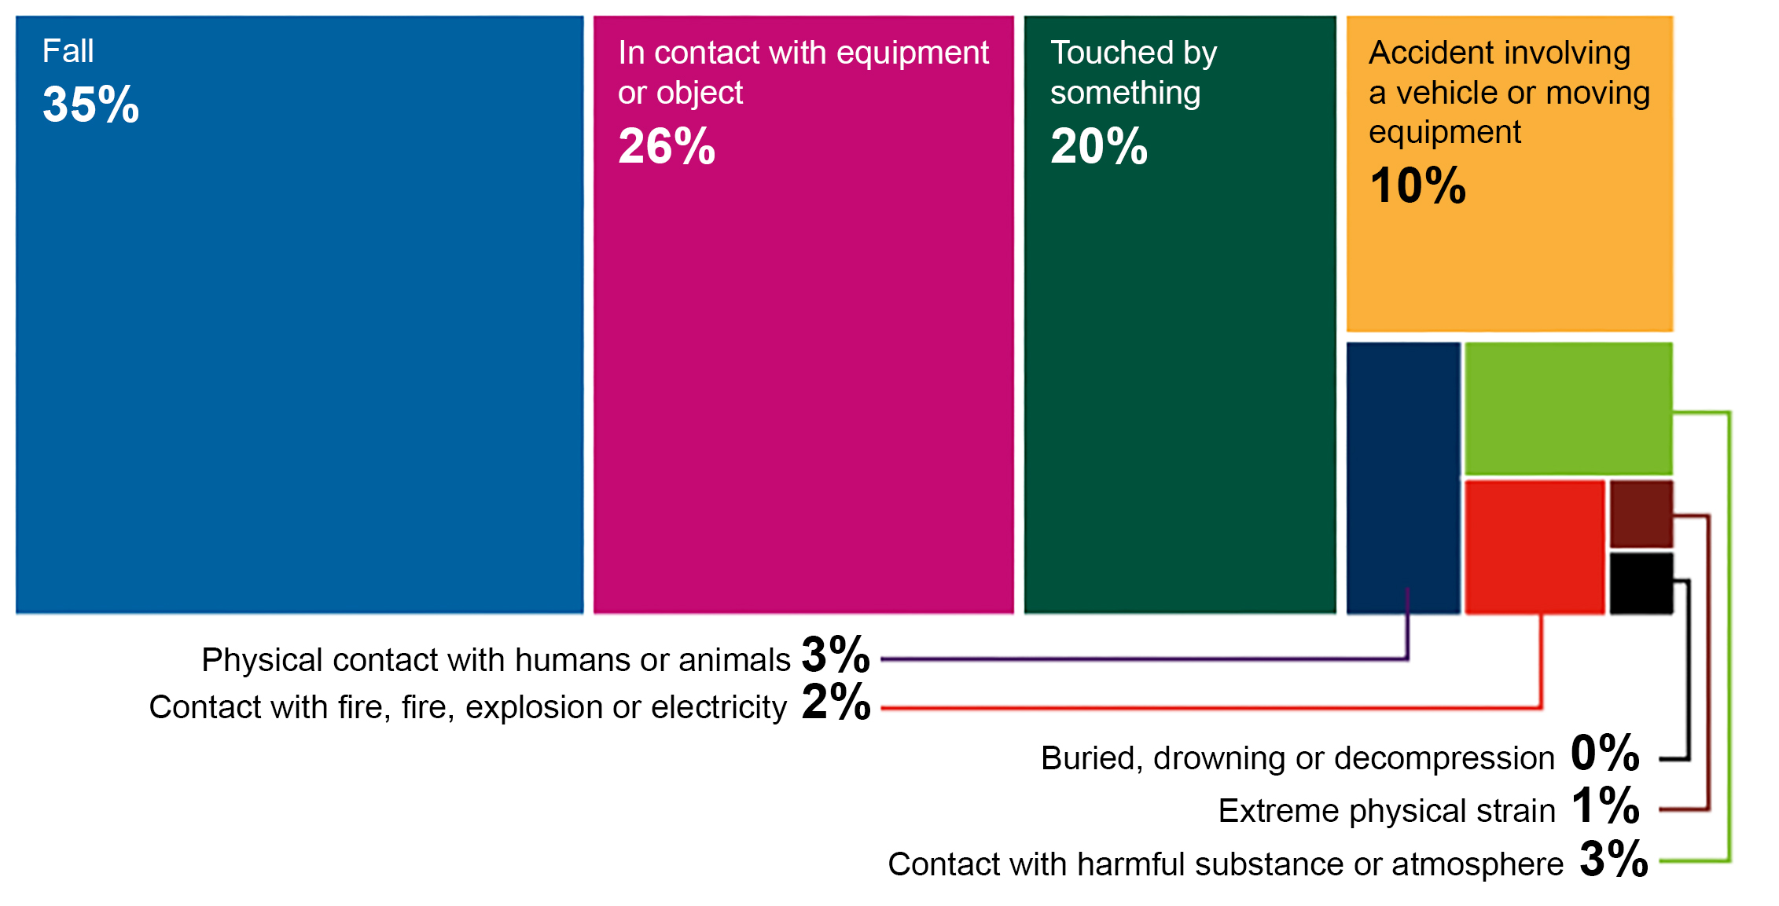
Safe and healthy working practices | Machine safety: Drill press
Why machine safety?
Accident investigations completed in 2023, broken down by accident type.
Large proportion of the number of reported occupational accidents.
Contact with work equipment or object 26%.
Source: Work Accident Monitor 2023 – Dutch Labour Inspectorate
Notes:
https://www.nlarbeidsinspectie.nl/publicaties/rapporten/2024/08/26/monitor-arbeidsongevallen-2023
The accident type "Contact with work equipment or object" is common in the Industrial sector (42% of accidents in that sector). The majority of accidents involve accidents in which the victim came into contact with moving parts of a machine (69%).

Slide 4
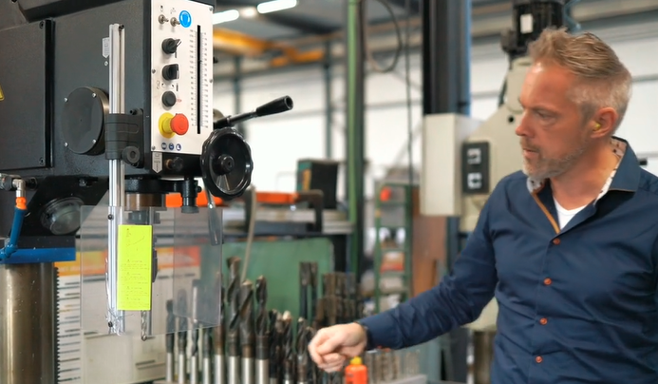
Guard missing.
Safe and healthy working practices | Machine safety: Drill press
Why machine safety?
Cause of contact with moving parts:
Guard missing, but insufficiently effective.
Guard removed.
Incorrect operation.
Notes:
1 mg applies to normal welding processes, stainless steel is even less because of Chromium 6 (carcinogenic).

Slide 5
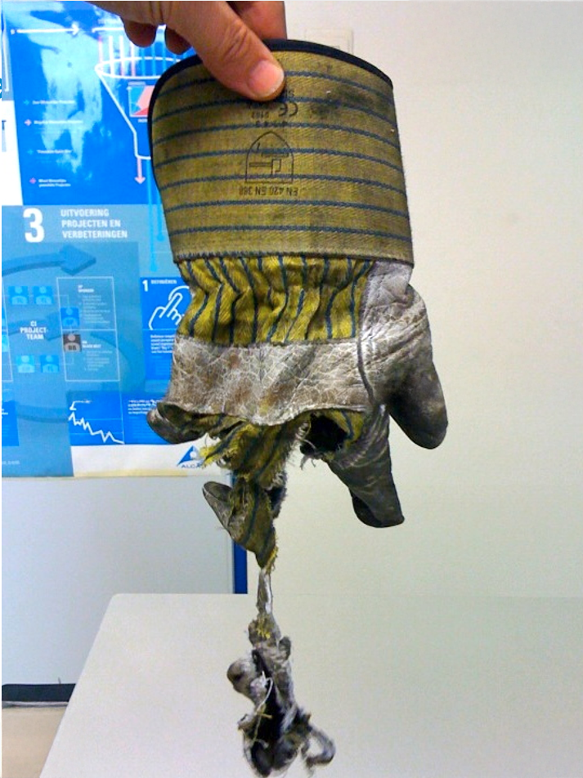
Gloves caught by the drill.
Safe and healthy working practices | Machine safety: Drill press
Drill press accidents: top 3
Workpiece not clamped or insufficiently clamped.
Clothing/jewellery/hair caught by the drill.
Serious and permanent injury:
Amputation and fractures of fingers or fingertips resulting in loss of function.
Notes:
1 mg applies to normal welding processes, stainless steel is even less because of Chromium 6 (carcinogenic).

Slide 6
Protection of the drill head:
- the drill head and drill are shielded with a protective guard OR
- the drill is switched off in the highest position OR
- the drill is secured with a trip device;
Safe and healthy working practices | Machine safety: Drill press
Safe machine
Clamping mechanism present and in use.
Emergency stop present and within reach.
Drill press set up in a stable position.
Power cables, plugs and connections undamaged.
Zero voltage protection present.
Notes:
1 mg applies to normal welding processes, stainless steel is even less because of Chromium 6 (carcinogenic).

Slide 7
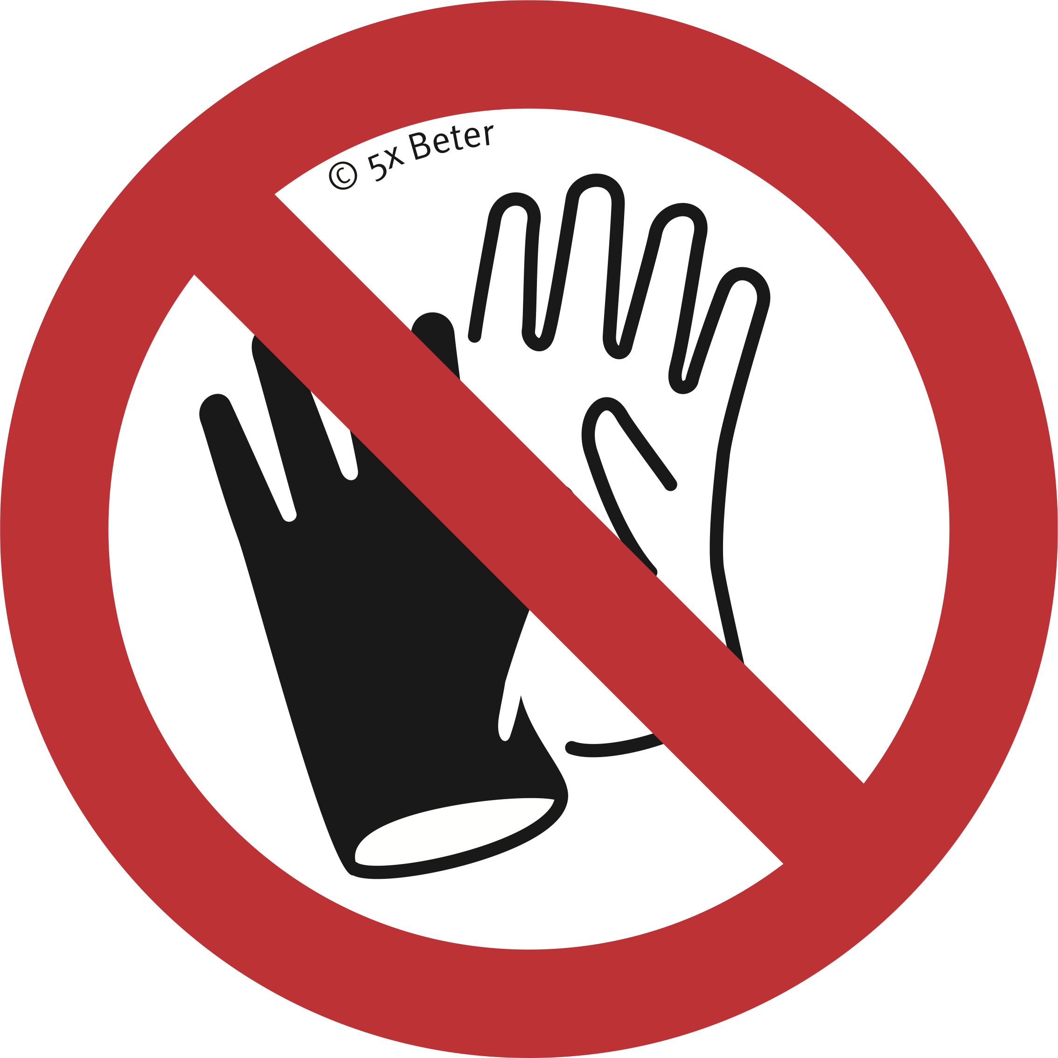

Safe and healthy working practices | Machine safety: Drill press
What can you do yourself?
Do not wear gloves.
Test the emergency stop.
Always wear safety goggles.
Switch off the drill press after drilling and when clamping new material.
Prevent clothing, jewellery and hair from getting caught in the drill.
Only remove residues and chips when the drill press is switched off.
Remove unnecessary tools from the drilling table.
Keep the drive guard closed.
Ensure a safe, clean and tidy environment.
Notes:
1 mg applies to normal welding processes, stainless steel is 1 µg/m³ due to Chromium 6 (carcinogenic). µg per m³ = microgram per cubic meter.

Slide 8
Safe and healthy working practices | Machine safety: Drill press
What can you do yourself?
Ensure the stability of the machine and the workpiece by using roller conveyors or roller stands, for example.
Never bypass safety devices.
If safety devices are missing or have been bypassed, discuss this with your manager.
Do not start work if you have any doubts about the safety of the machine; discuss this with your manager.
Notes:
1 mg applies to normal welding processes, stainless steel is 1 µg/m³ due to Chromium 6 (carcinogenic). µg per m³ = microgram per cubic meter.

Slide 9

Safe and healthy working practices | Machine safety: Drill press
Questions?
info@5xbeter.nl | www.5xbeter.nl

Slide 10
Safe and healthy working practices | Machine safety: Drill press
Need help?
Discuss it with your manager or contact the health and safety officer.
Consult an Improvement Coach from 5xbeter: www.5xbeter.nl
Or call the FREE Improvement Line: 0800 – 55 55 005
info@5xbeter.nl | www.5xbeter.nl

